Slide 1
Lab Lecture One
Intro to NOS3 & Sat Ops

Slide 2
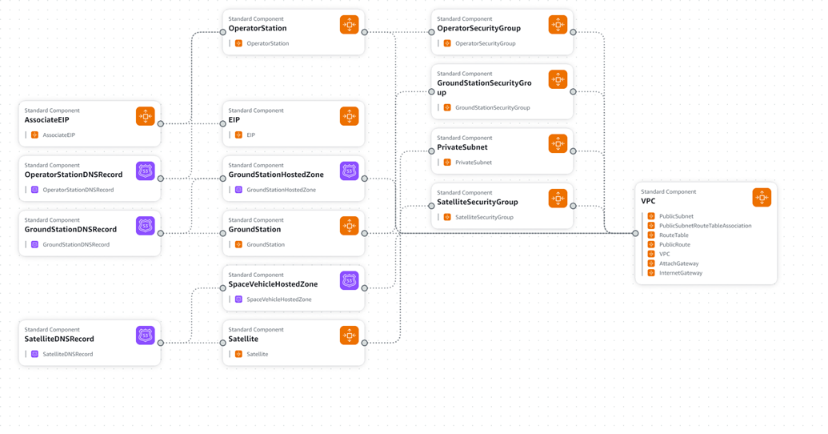

Infrastructure Diagram

Slide 3
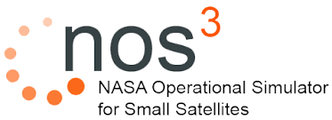
The NASA Operational Simulator for Small Satellites (NOS3) is a suite of tools developed by NASA's Katherine Johnson Independent Verification and Validation (IV&V) Facility to aid in areas such as software development, integration & test (I&T), mission operations/training, verification and validation (V&V), and software systems check-out. NOS3 provides a software development environment, a multi-target build system, an operator interface/ground station, dynamics and environment simulations, and software-based models of spacecraft hardware.
This project is licensed under the NOSA (NASA Open Source Agreement) License.
https://opensource.gsfc.nasa.gov/documents/NASA_Open_Source_Agreement_1.3.txt

Slide 4
Canvas Credentials
Satclass@finalfrontiersecurity.com / space_pirate11!!
https://canvas.finalfrontiersecurity.com

Slide 5
Regarding the lab…
Why no Kali?
Mantle of insider access necessary whether insider threat or APT
Adds complexity
Nothing space specific
Surely would be incorporated for red team or longer classes or a true range / lab scenario

Slide 6
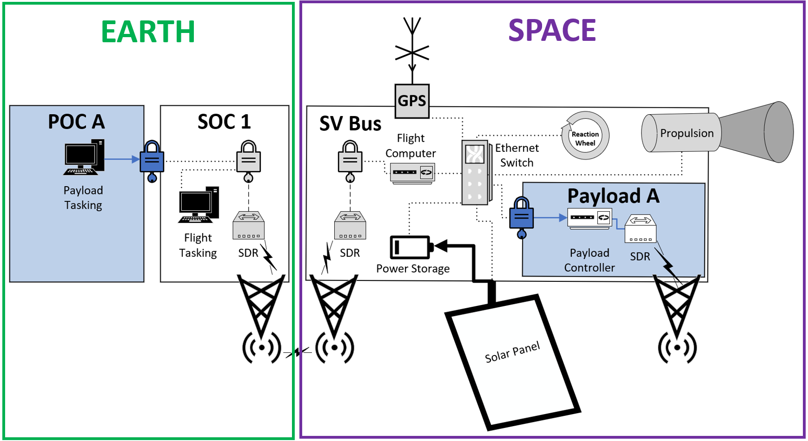
Lab component reference: COSMOS
Notes:
There are other sw suites

Slide 7
Lab component reference: Telemetry source for 42

Slide 8
Lab component reference: Target Device

Slide 9
Flight Computer
Space Operations Station
Flight Software (cFS)
Reaction Wheels
Commands
CCOSMOS
Commands
Commands
ADCS
Telemetry
Telemetry
Telemetry
Telemetry
GPS Receiver
Garak
Commands
Pub-Sub SW Bus
Telemetry
Solar Panels
42 Server
(Environment Emulation)
42 Client
(visualization)
Telemetry
Telemetry

Slide 10
Following students please refresh the table and grab your new IP
Students:
27
38
39
40
41
42
43
45

